Slide 1
Introduction to Counterparty Credit Risk (CCR) and Valuation Adjustments (XVA)
Introduzione all’Ingegneria Finanziaria Seminario Professionalizzante
Vincenzo Eugenio Corallo, Ph. D
Sapienza Università di Roma
vincenzo.corallo@uniroma1.it

Slide 2
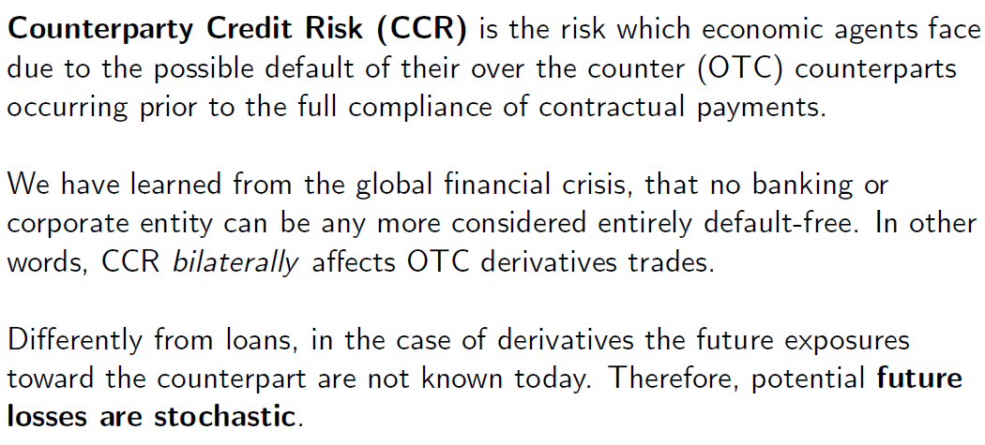
Counterparty Credit Risk (CCR) definition

Slide 3
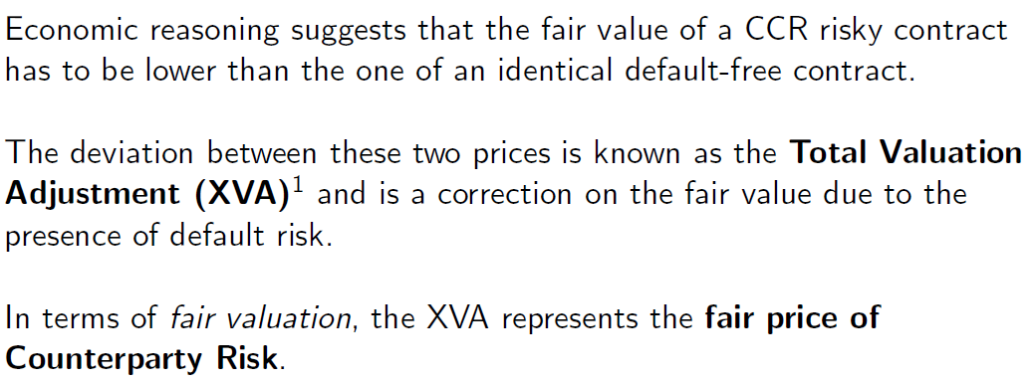
Consequences of XVAs on fair pricing

Slide 4
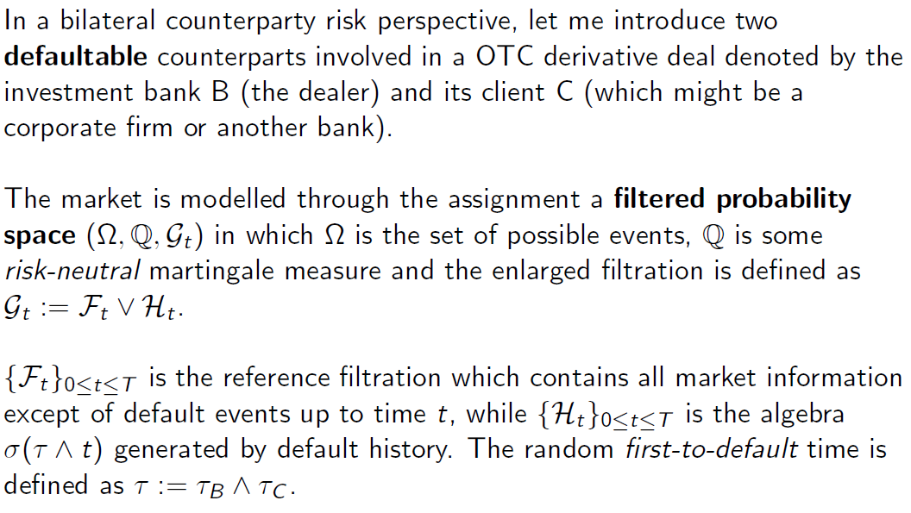
Model set-up

Slide 5
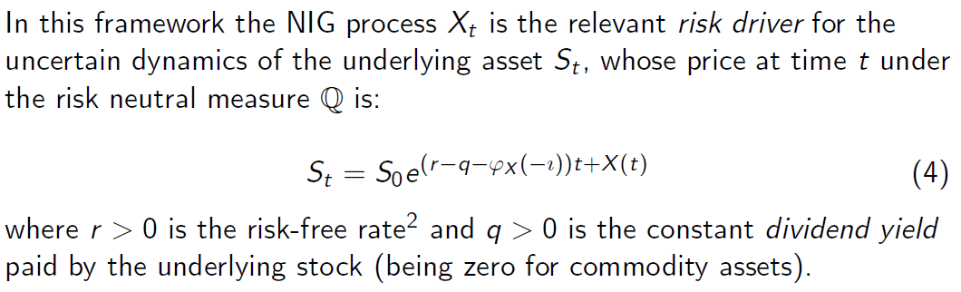

Firm equity dynamics

Slide 6
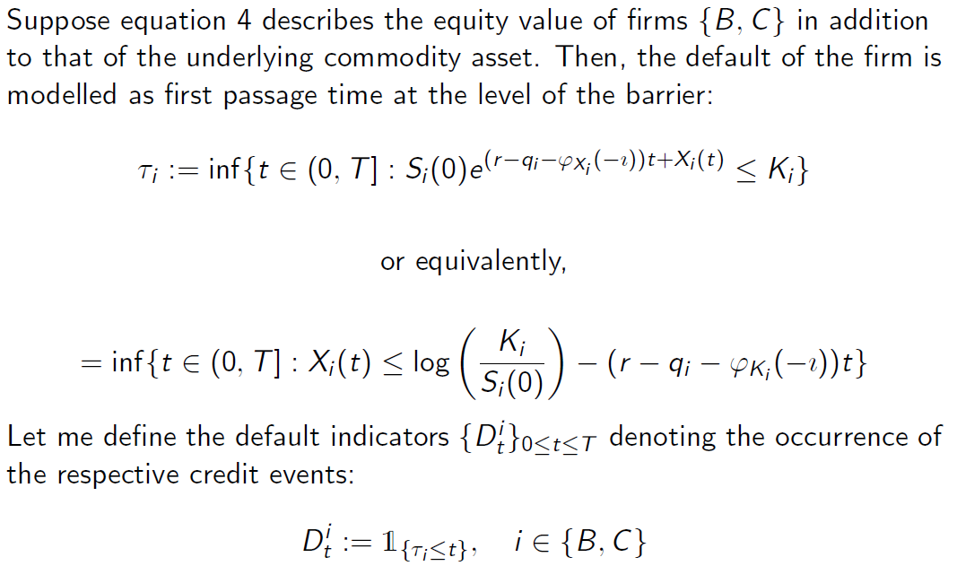
Default event

Slide 7
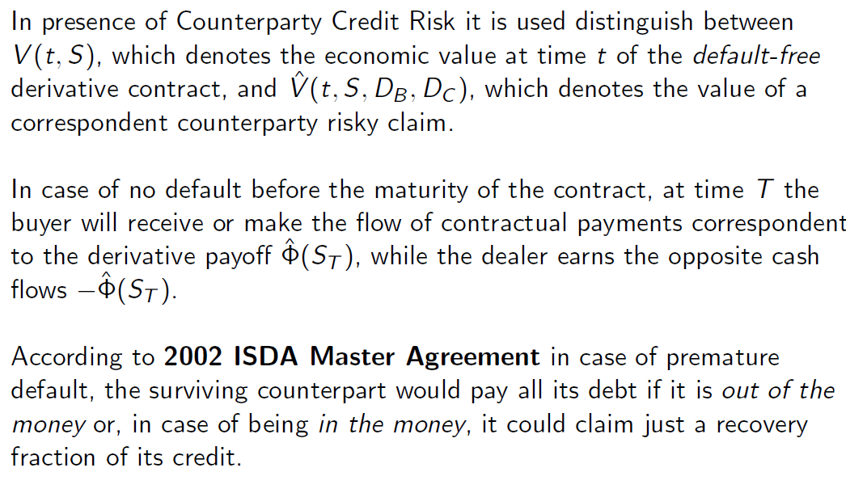
ISDA Master Agreements

Slide 8
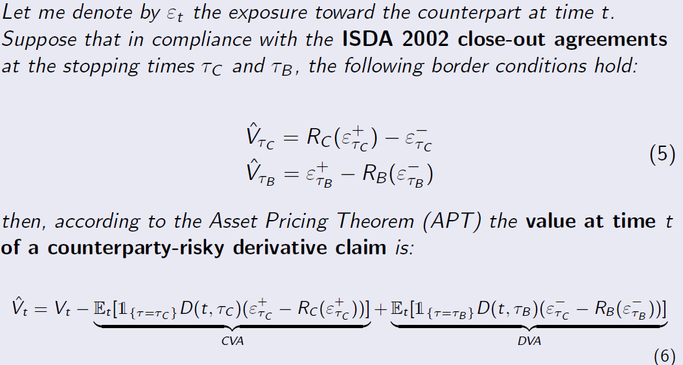
Bilateral CCR pricing

Slide 9
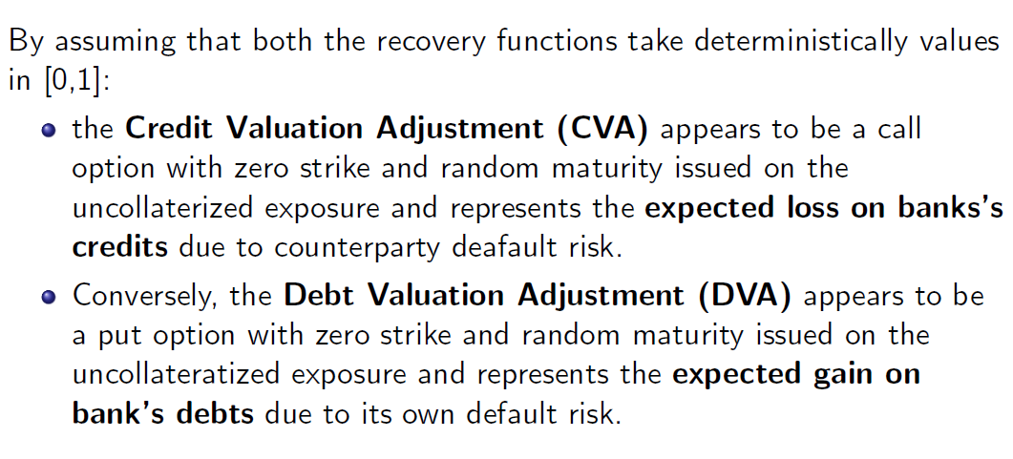
The price of CCR: economic interpretation

